Slide 1
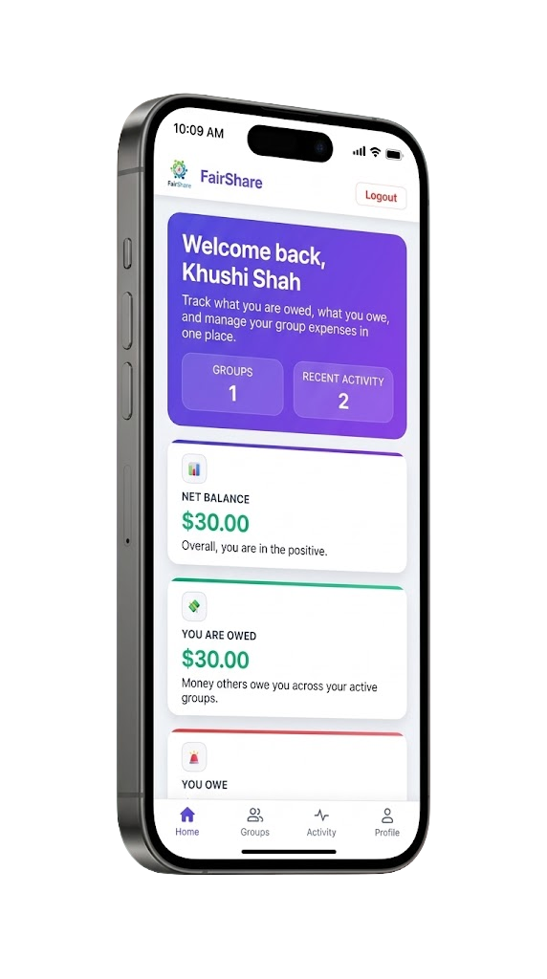



FAIRSHARE SPRINT - 3
KHUSHI SHAH

Slide 2
SPRINT 1: STORIES
04
ADD EXPENSE
01
USER SIGNUP & LOGIN
05
EDIT/DELETE EXPENSE
02
CREATE GROUP
06
EQUAL EXPENSE SPLIT
03
JOIN GROUP VIA INVITE CODE
07
BASIC BALANCE DASHBOARD
TOTAL STORY POINTS: 37

Slide 3
SPRINT 2: STORIES
01
SELECT PARTICIPANTS FOR AN EXPENSE
02
PERCENTAGE-BASED EXPENSE SPLIT
03
ATTACH RECEIPTS TO EXPENSES
TOTAL STORY POINTS: 21

Slide 4
SPRINT 3: STORIES
EXPORT BALANCE SHEET (SP: 5)
GENERATE SETTLEMENT PLAN (SP: 8)
CLEAR ALL DEBTS (SP: 8)
ZELLE INTEGRATION (SP: 5)
Export balance sheet as PDF/CSV
Includes all:
Users
Expenses
Net balances
Data matches dashboard
System generates instructions:
“A pays B $X”
Minimizes number of transactions
Updates balances after settlement
Option to mark all debts as settled
Resets balances to zero
Dashboard reflects cleared state
Add Zelle email / phone
Upload QR code for payments

Slide 5
SPRINT ESTIMATION &
PROJECT COMPLETION
37
21
26
26
SPRINT 1 VELOCITY
SPRINT 2 VELOCITY
SPRINT 3 VELOCITY
MEDIAN VELOCITY
All planned features successfully completed within 3 sprints, achieving MVP goals with 90% confidence interval reliability.
Total sprints required were 3.
No additional sprint is needed

Slide 6
TESTING AND COVERAGE
TOOLS (SPRINT 3)
JUNIT 5
MOCKITO
MAVEN SUREFIRE
Unit testing framework for backend logic verification
Mocking dependencies including services and repositories
Automated test execution across all test suites
JACOCO
DESIGNITEJAVA
VITEST
Comprehensive code coverage measurement and reporting
Detect architecture, design and implementation smells
Frontend logic testing
GITHUB ACTIONS
Implemented CI/CD with GitHub Actions to automate testing and ensure consistent code coverage on every push

Slide 7
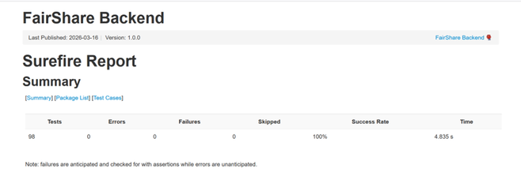
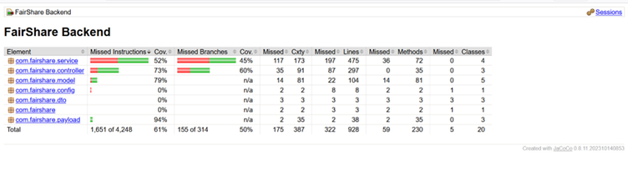
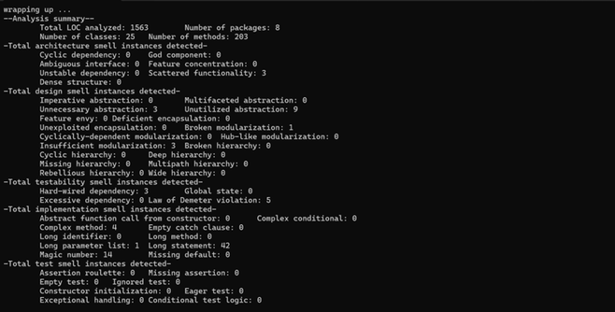
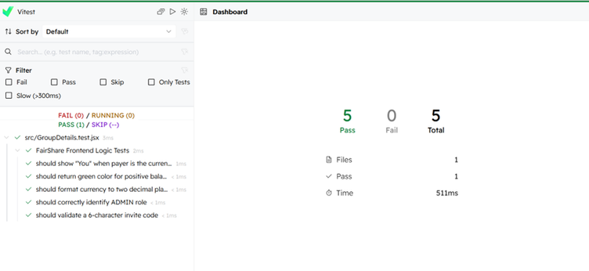
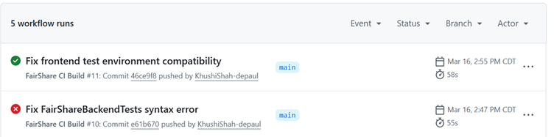
Backend tests were executed using Maven Surefire Plugin.
A total of 98 automated unit tests were run.
0 errors, 0 failures, and 0 skipped tests, resulting in a 100% success rate.
The total test execution time was approximately 4.8 seconds.
This confirms that the backend functionalities passed all implemented test cases successfully.
Code coverage was measured using the JaCoCo coverage tool integrated with Maven.
The backend achieved 61% overall code coverage.
Controller layer coverage reached 73%, indicating strong API testing.
Service layer coverage is 52%, reflecting testing of core business logic.
Model and payload classes achieved 79% and 94% coverage respectively.
Some configuration and DTO classes remain untested because they mainly contain simple data structures or configuration code.
Github Actions show both successful and unsuccessful builds
Analyzed 1563 LOC, 25 classes, 203 methods using DesigniteJava
No major architecture smells → system is well-structured
Minor issues found (long statements, unused abstractions) → scope for improvement
Frontend logic testing was implemented using Vitest. The tests verify UI logic such as user display names, role identification, currency formatting, and invite code validation.

Slide 8
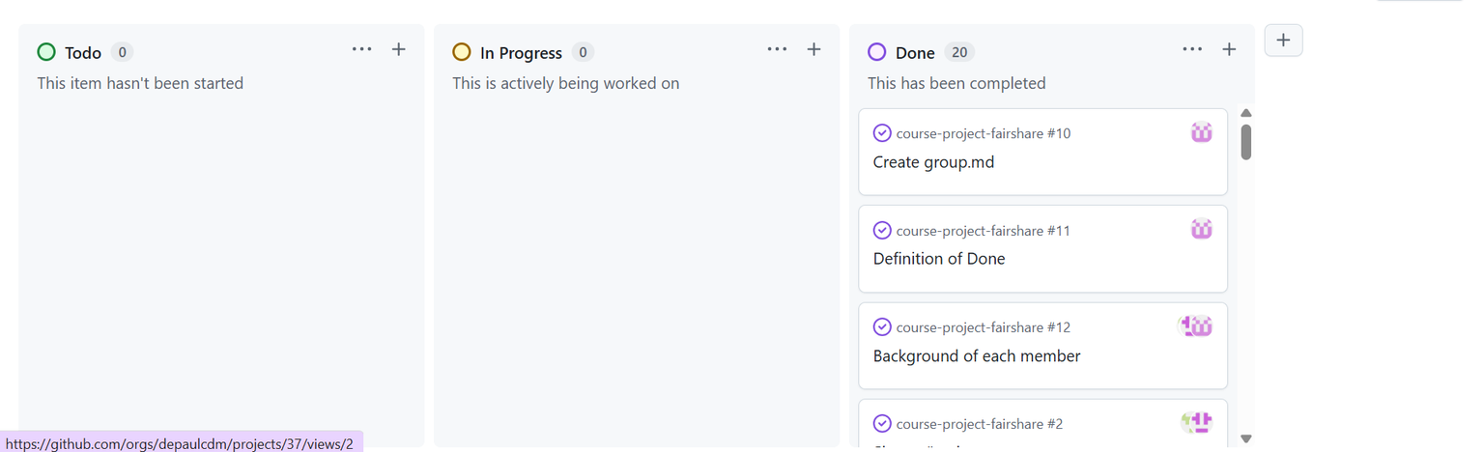
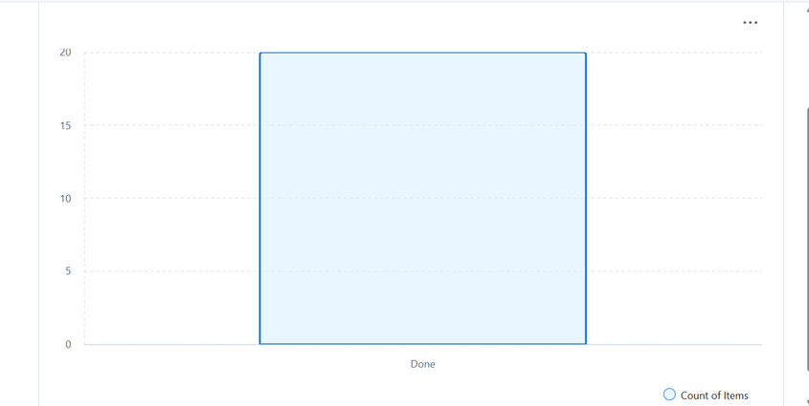
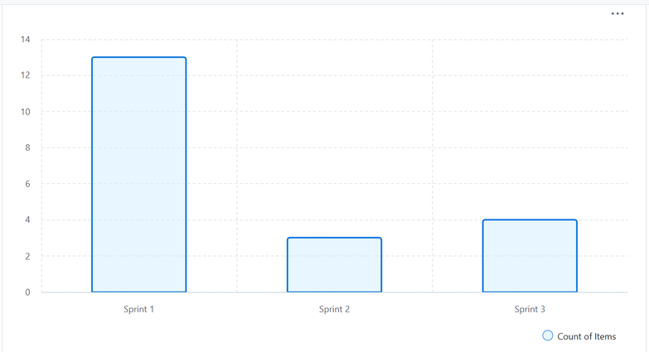
PLANNING BORAD IN GITHUB
ALL PLANNED TASKS WERE SUCCESSFULLY COMPLETED, REFLECTING A 100% SPRINT COMPLETION RATE.
SPRINT 1 HAD THE HIGHEST WORKLOAD, FOLLOWED BY A DROP IN SPRINT 2 AND A SLIGHT INCREASE IN SPRINT 3, SHOWING STABILIZED PROGRESS

Slide 9
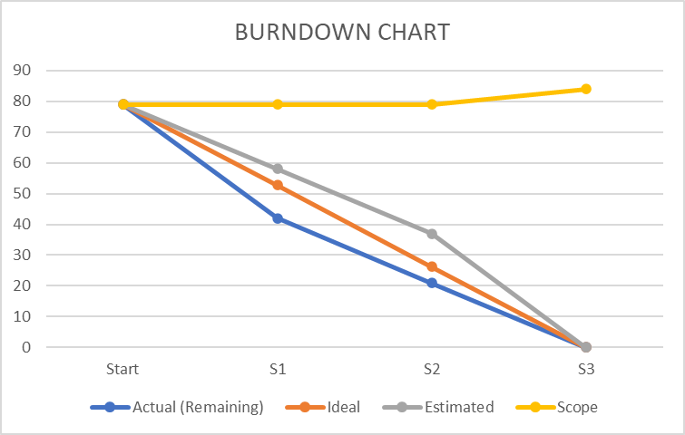
OUR DEVELOPMENT PROCESS
BURNDOWN
CHART
Agile-Based Development Lifecycle
01
03
05
07
REQUIREMENT
GATHERING
SYSTEM DESIGN
TESTING
REVIEW &
RETROSPECTIVE
02
04
06
SPRINT PLANNING
DEVELOPMENT
CONTINUOUS
INTEGRATION
The burndown chart shows steady progress across sprints, with a scope increase in Sprint 3 that was successfully completed within the release.

Slide 10
KEY METRICS - ALL SPRINTS
SPRINT 1
SPRINT 2
SPRINT 3
•Planned Velocity: 37 points
•Actual Velocity: 37 points
•Sprint Predictability Rate: 100%
•Sprint Addition Rate: 0%
•Sprint Completion Rate: 100%
All actions were kept and evaluated
•Planned Velocity: 21points
•Actual Velocity: 21 points
•Sprint Predictability Rate: 100%
•Sprint Addition Rate: 0%
•Sprint Completion Rate: 100%
All actions were kept and evaluated
•Planned Velocity: 21 points
•Actual Velocity: 26 points
•Sprint Predictability Rate: 81%
•Sprint Addition Rate: 24%
•Sprint Completion Rate: 100%
One additional action was added and evaluated
Overall, Sprint 1 and Sprint 2 demonstrated strong planning accuracy with 100% predictability and completion. In Sprint 3, although predictability decreased due to the addition of a new feature, the team successfully adapted and delivered all planned and additional work. This highlights our ability to balance planning discipline with flexibility, ensuring both consistency and value delivery throughout the project.

Slide 11
SPRINT 3 - RETROSPECTIVE
re
re
re
STOP
START
CONTINUE
Adding new features mid-sprint without buffer planning
Slight deviation from initial sprint commitment
Relying more on manual coordination instead of structured tracking
Early discussion before introducing scope changes
Improving estimation accuracy for dynamic features
Strengthening communication between frontend & backend
Completing all committed and additional tasks
Using CI/CD tools (GitHub Actions, testing pipelines)
Maintaining transparency through regular updates

Slide 12
THANK
YOU
DEMONSTRATION: https://youtu.be/GIe5kEu0w4Q

